Slide 1
Available File Formats
Text / CSV
JSON
SequenceFile
binary key/value pair format
Avro
Parquet
ORC
optimized row columnar format

Slide 2
Key Factors
Parquet, ORC, and Avro are three popular file formats for big data management, each with their own unique benefits and use cases.
Parquet and Avro are optimal for cloud data storage and provide meaningful insights, while ORC is suitable for managing relevant data.
When choosing a file format, consider factors such as use case, data relevance, and storage efficiency, query performance, compression, and compatibility with various processing frameworks.

Slide 3
AVRO
Language neutral data serialization system
Write a file in python and read it in C
AVRO data is described using language independent schema
AVRO schemas are usually written in JSON and data is encoded in binary format
Supports compression and are splittable
Row storage each row gets stored as block

Slide 4
AVRO – Best suited for
Data Serialization and Deserialization
When data needs to be transmitted across different services or stored in a data warehouse
Schema Evolution
Supports schema evolution, allowing changes to data schemas over time without breaking backward
Streaming Data Processing
Commonly used in data streaming platforms like Apache Kafka due to its compact size and fast read/write capabilities.
Supports Complex Data types

Slide 5
Use Cases of Avro
Data Storage in HDFS: Avro is often used with Apache Hadoop and HDFS to store large volumes of structured data.
Stream Processing: Avro is frequently used with Apache Kafka for data streaming, as it allows efficient serialization and deserialization of messages.
Data Interchange: It is used for exchanging data between different systems (e.g., between microservices, between databases, etc.), where the schema provides a clear structure for the data.

Slide 6
Parquet
columnar storage format
key strength is to store nested data in truly columnar format using definition and repetition levels.
Support schema Evolution
It aims to optimize query performance and minimize I/O, making it ideal for cloud data storage and big data processing.
Suitable for analytical workloads

Slide 7
Parquet– Best suited for
Analytical Query Processing
Highly efficient for analytical queries that involve scanning large datasets and aggregating data
Data Warehousing
Commonly used in data warehousing solutions due to its efficient storage and querying capabilities.(Amazon Redshift Spectrum , Google BigQuery)
Big Data Processing with Hadoop Ecosystem
Integrates well with big data processing frameworks like Apache Spark, Apache Hive, and Apache Impala

Slide 8
Parquet– Best suited for
Compression and Storage Efficiency
Advanced compression techniques, reducing storage requirements and improving I/O performance(compression algorithms like Snappy, Gzip)
Integration with Cloud Services
Cloud services like Amazon S3, Google Cloud Storage, and Azure Blob Storage support Parquet, allowing efficient storage and access.

Slide 9
ORC Format
Invented in 2013, by the Apache Hadoop community
Columnar storage
optimize the handling of large-scale data in big data systems
It accomplishes this by offering a highly efficient method of storing and managing data.

Slide 10
ORC – Key Features
Efficient storage
High compression rates
Fast query performance
Supports complex data types
Completely self dependent
Enhancing versatility and providing additional insights
valuable asset in big data environments

Slide 11
ORC – Best Suited for
Data Warehousing and Analytical Queries
Significant performance benefits due to its columnar storage and compression capabilities (performs complex queries in historical large volumes of data like sales trends
High compression efficiency
High compression rates, which reduces storage costs and improves I/O performance (used lightweight compression algorithms like Zlib)

Slide 12
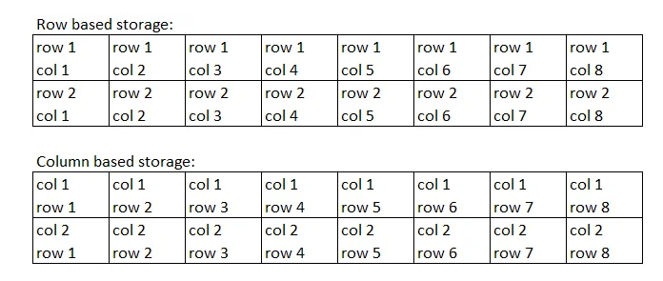
Row/Column Storage

Slide 13
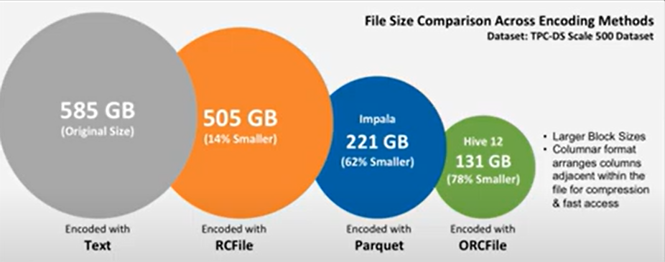
Compression Percentage

Slide 14
SQOOP
Cloudera 2009
Moving data between Hadoop and RDBMS
SQOOP is a MR tool for importing data from RDBMS and Hadoop
SQOOP convert import command into Map only Job to import data
Parallel Map tasks help importing the data transfer
SQOOP uses JDBC connection of databases to run the query and fetch the data

Slide 15
SQOOP - SQL+Hadoop
Sqoop can import
RDBMS -> Hadoop
RDBMS -> Hive
RDBMS ->Hbase
Sqoop can Export
HDFS – RDBMS
Hive -> RDBMS
Hbase -> RDBMS not possible

Slide 16
Importing a Table from Mysql to Hive
We use import command to table from sql to hive
sqoop import \
--connect jdbc:mysql://hostname/dbname \
--username myusername \
--password mypassword \
--table mytable \
--hive-import \
--create-hive-table \
--hive-database myhivedb

Slide 17
Incremental Imports
Append Mode: Imports rows where a specified column has a value greater than the maximum value from the last import.
Lastmodified Mode: Imports rows where a specified timestamp column has a value greater than the last import time.
sqoop import \
--connect jdbc:mysql://hostname/dbname \
--username myusername \
--password mypassword \
--table mytable \
--incremental [append|lastmodified] \
--check-column column_name \
--last-value last_imported_value \
--target-dir /path/to/hdfs/directory

Slide 18








Sqoop
Node on which is Sqoop is installed
Hadoop Cluster
Submit MapReduce Job
Map
Node 1
JDBC
Fetch Metadata
Map
Node 2
Map
Node 3
sqoop import
--connect jdbc:mysql://<Server Name>/<Database>
--username <User name>
--password <Password>
--table <Table Name>
Map
Node 4

Slide 19
Scoop Now in the Market
The database connectivity capabilities of Spark make it the most flexible solution
Apache Kafka and Apache NiFi are faster alternatives
SQOOP results into MR Jobs only

